Slide 1

Counterclaim for Divorce
By, Tanner Murphy
Coding the Law
Suffolk University Law School

Slide 2
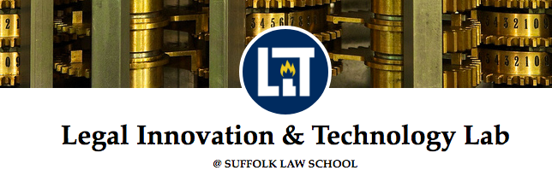

Slide 3
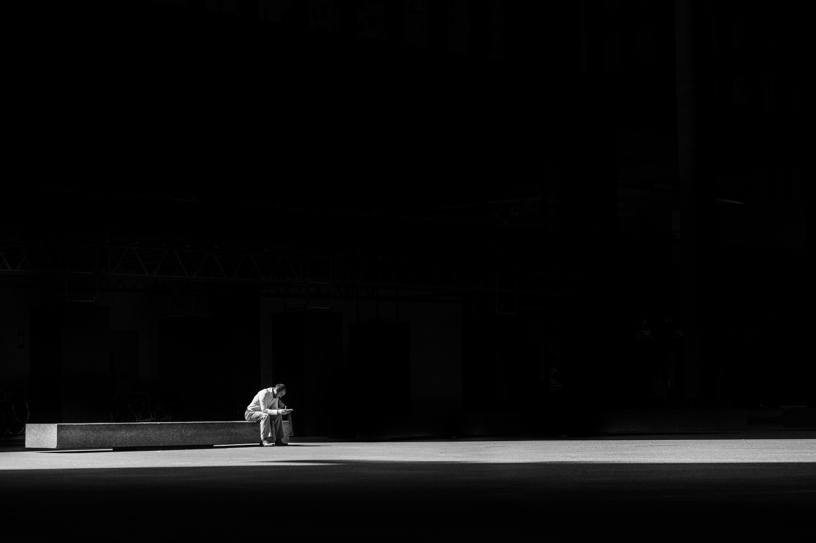
Stakeholders
defendant to the original divorce claim, aka, “plaintiff-in-counterclaim.”
Probate Courts

Slide 4
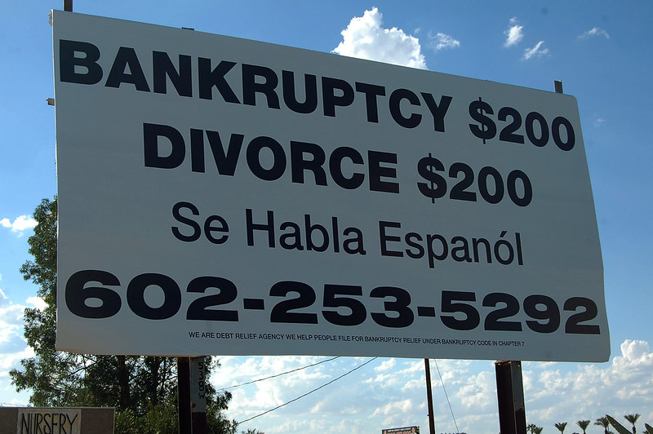

Slide 5
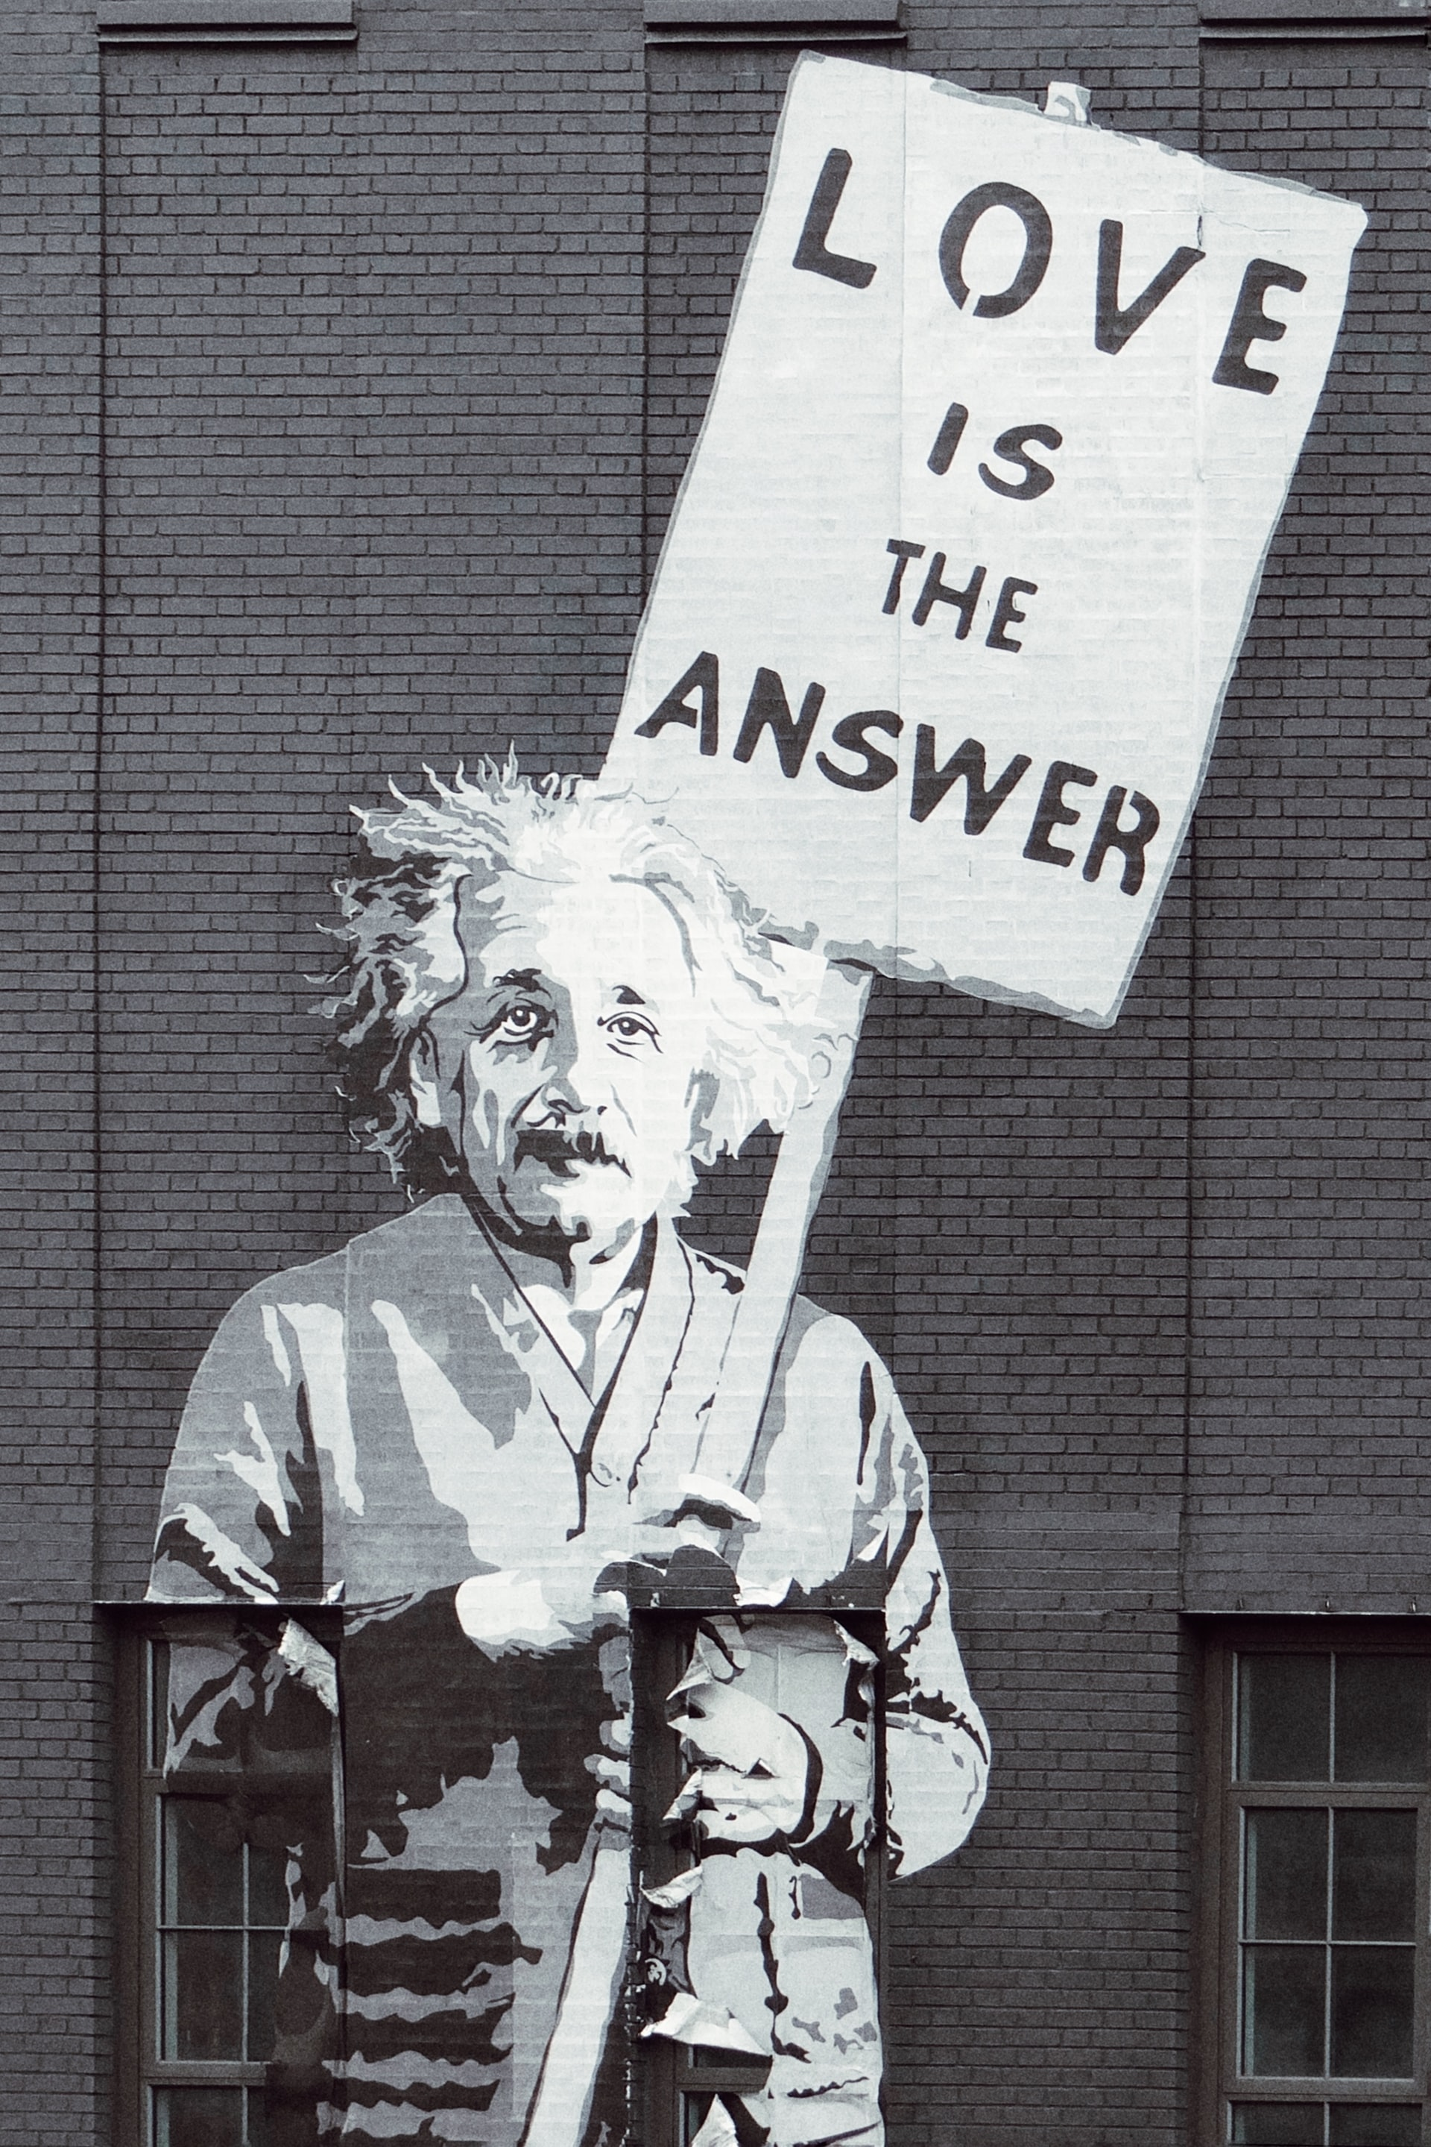
Solutions?

Slide 6
Questions?

